Slide 1


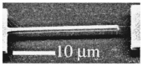
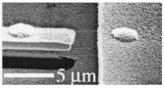
Mechanical Properties
Why mechanical properties?
Many materials, when in service, are subjected to forces or loads; examples include….
e.g. materials used in
building bridges that can
hold up automobiles,
pedestrians…
materials for
skyscrapers
in the Windy
City…
materials for
NASA exploration…
materials for and designing
MEMs and NEMs…
Space elevators?

Slide 2
Issues to address…
• Stress and strain
• Elastic behavior
• Plastic behavior
• Strength, ductility, resilience, toughness, hardness
• Mechanical behavior of different classes
of materials

Slide 3
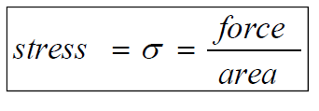
CONCEPTS OF STRESS AND STRAIN
Stress: Pressure due to applied load.
e.i.: tension, compression, shear, torsion, and combination.
Strain: response of the material to stress
(i.e. Physical deformation such as elongation due to tension).

Slide 4
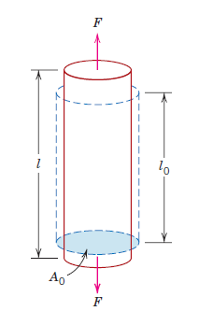
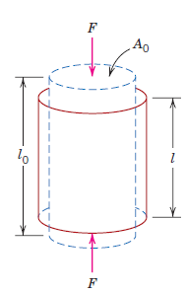
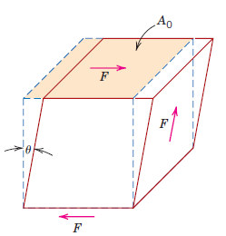
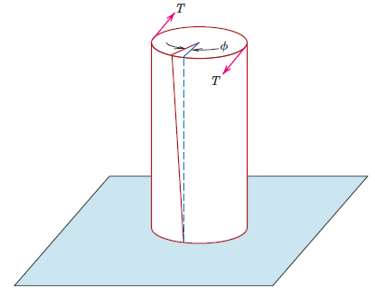
CONCEPTS OF STRESS AND STRAIN
Stress: Pressure due to applied load.
Strain: response of the material to stress
Schematic illustration of different kinds of stresses & responded strains
TENSILE
COMPRESSIVE
SHEAR
TORSION
how a tensile load produces an elongation and positive linear strain. Dashed lines represent the shape before deformation; solid lines, after deformation.
how a
compressive load
produces contraction
and a negative linear
strain.
shear strain ɣ , where
ɣ= tan Ɵ
torsional
deformation (i.e.,
angle of twist Ø )
produced by an
applied torque T.

Slide 5
CONCEPTS OF STRESS AND STRAIN
Stress: Pressure due to applied load.
Strain: response of the material to stress
COMMON STATES OF STRESS

Slide 6
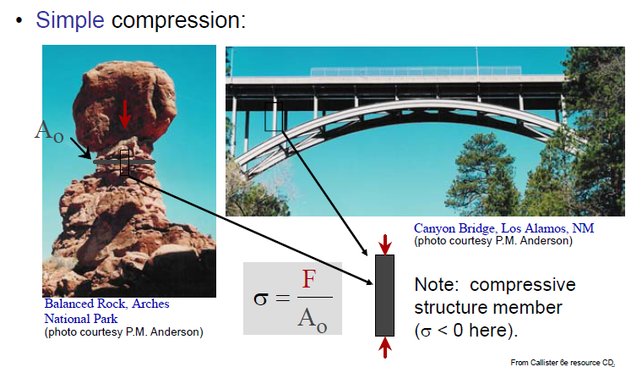
CONCEPTS OF STRESS AND STRAIN
Stress: Pressure due to applied load.
Strain: response of the material to stress
COMMON STATES OF STRESS

Slide 7


CONCEPTS OF STRESS AND STRAIN
Stress: Pressure due to applied load.
Strain: response of the material to stress
COMMON STATES OF STRESS
• Bi-axial tension:
• Hydrostatic compression:
Pressurized tank
Fish under water
σ
> 0
θ
σ < 0
h
σ
z
> 0
Also called as isostatic

Slide 8
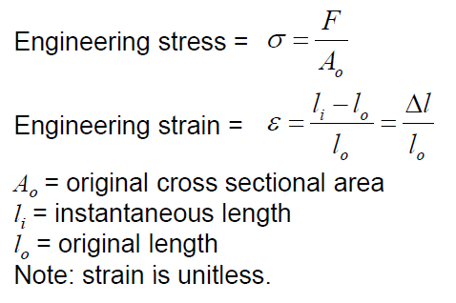
CONCEPTS OF STRESS AND STRAIN
Stress: Pressure due to applied load.
Strain: response of the material to stress
Tension and Compression
Tension
megapascals, MPa (SI) (where 1 MPa= 10⁶ N/m²), and pounds force per square inch, psi
Newton (N) or pounds force (ıbf)
m² or in²
Compression
Same as tension but in the opposite direction (stress and strain defined in the same manner).
By convention, stress and strain are negative for compression.

Slide 9
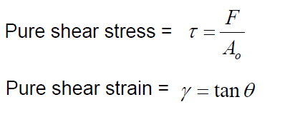
CONCEPTS OF STRESS AND STRAIN
Stress: Pressure due to applied load.
Strain: response of the material to stress
Shear

Slide 10
Elastic Deformation
1. Initial
2. Small load
3. Unload
bonds
stretch
return to
initial
δ
F
F
Linear-
elastic
Elastic means reversible!
Non-Linear-
elastic
δ

Slide 11
Plastic Deformation

Slide 12
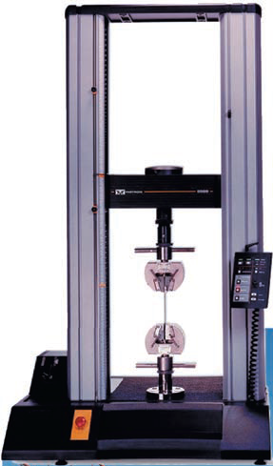
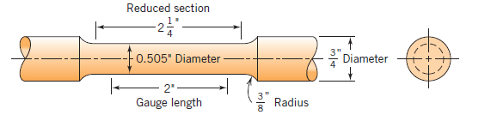
Tension Tests
One of the most common mechanical stress–strain tests
be used to ascertain several mechanical properties of materials that are important in design.
A specimen is deformed, usually to fracture, with a gradually increasing tensile load that is applied uniaxially along the long axis of a specimen.
A standard tensile specimen
The cross section is circular, but rectangular specimens are also used
Schematic representation of the
apparatus used to conduct tensile
stress–strain tests. The specimen is
elongated by the moving crosshead; load
cell and extensometer measure, respectively, the magnitude of the applied load and the elongation.
The output of such a tensile test is recorded (usually on a computer) as load
or force versus elongation

Slide 13
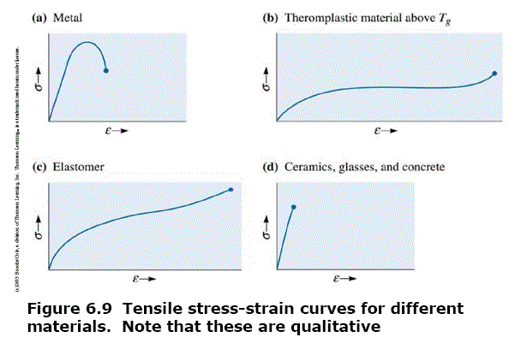

Slide 14
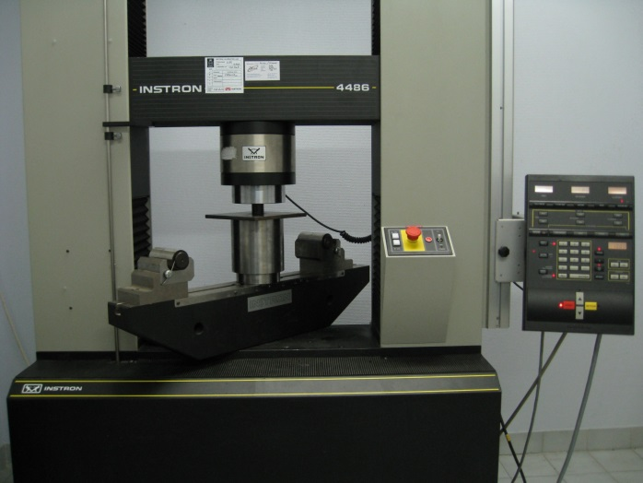
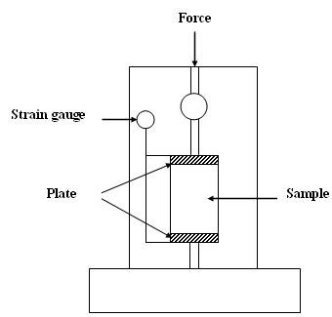
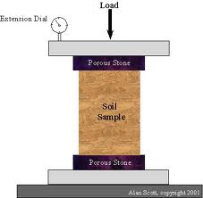
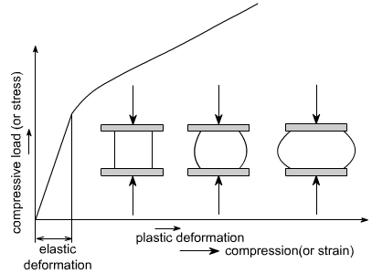
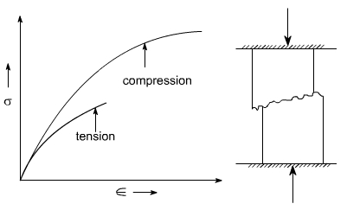
Compression Tests
Compression stress–strain tests may be conducted if in-service forces are of this type.
A compression test is conducted in a manner similar to the tensile test, except that the force is compressive and the specimen contracts along the direction of the stress.
Ductile materials: For ductile material such as mild steel, the load vs compression diagram would be as follows
Brittle materials in compression behave elastically up to certain load, and then fail suddenly by splitting or by craking

Slide 15
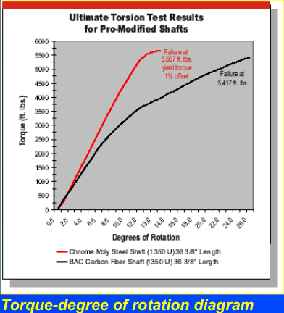
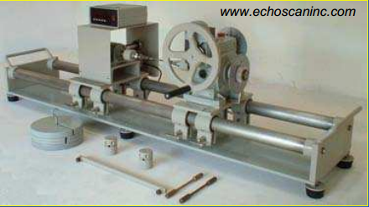
Torsional Tests
Torsion test is not widely accepted as much as tensile test.
Torsion tests are made on materials to determine such properties as the modulus of elasticity in shear, the torsion yield strength and the modulus of rupture.
Often used for testing brittle materials and can be tested in full-sized parts, i.e., shafts, axles and twist drills which are subjected to torsional loading in service
Torsion-testing equipment consists of
1) A twisting head, with a chuck for gripping the specimen and for applying the twisting moment to the specimen.
2) A weight head, which grips the other end of the specimen and measures the twisting moment of torque.
3) A circular cross section specimen is normally used since in the elastic range, shear stress varies linearly from a value zero at the centre of the bar to a maximum value at the surface.
Note: Thin-walled tubular specimen
is frequently used.
Determination is made of the angular
displacement (or degree of rotation) of
a point near one end of the test section of
the specimen with respect to a point on
the same longitudinal element at the
opposite end (using Troptometer)

Slide 16
Elastic Deformation
1. Initial
2. Small load
3. Unload
bonds
stretch
return to
initial
δ
F
F
Linear-
elastic
Elastic means reversible!
Non-Linear-
elastic
δ

Slide 17
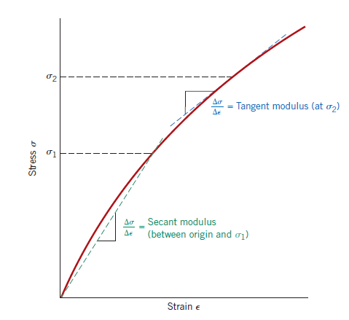
Elastic Deformation
-a non-permanent deformation where the material completely recovers to its original state upon release of the applied stress
There are some materials (e.g., gray cast iron, concrete, and many polymers) for which this elastic portion of the stress–strain curve is not linear.
For this nonlinear behavior, either tangent or secant modulus is normally used. Tangent modulus is taken as the slope of the stress–strain curve at some specified level of stress, whereas secant modulus represents the slope of a secant drawn from the origin to some given point of the curve.

Slide 18
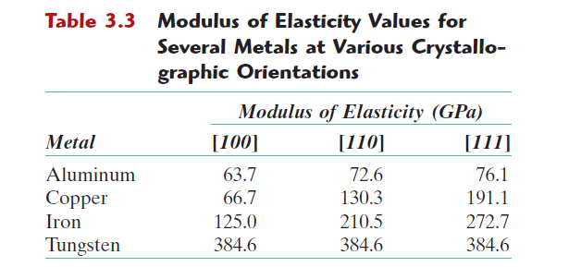
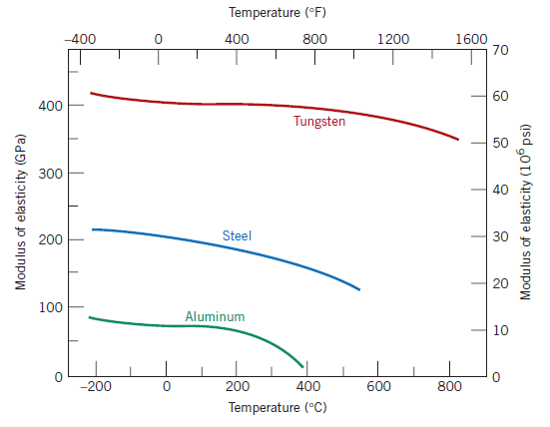
Elastic Deformation
Many materials are elastically anisotropic – dependent to orientation
Because the grain orientation is random in most polycrystalline materials, these may be considered to be isotropic; inorganic ceramic glasses are also isotropic (independent to orientation).
with increasing temperature, the modulus of elasticity diminishes

Slide 19
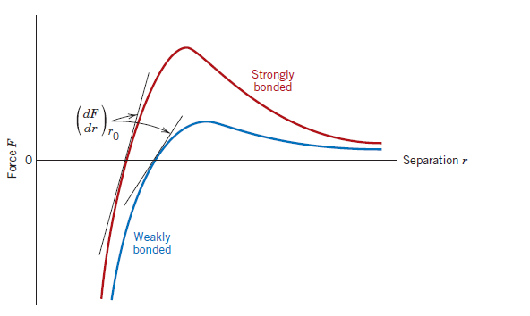
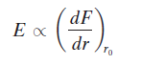
Elastic Deformation
On an atomic scale, macroscopic elastic strain is manifested as small changes in the interatomic spacing and the stretching of interatomic bonds.
As a consequence, the magnitude of the modulus of elasticity is a measure of the resistance to separation of adjacent atoms, that is, the interatomic bonding forces
Force versus interatomic separation for weakly and strongly bonded atoms. The magnitude of the modulus of elasticity is proportional to
the slope of each curve at the equilibrium interatomic separation r0.

Slide 20
The Comparision of modulus of elasticity (Young’s Moduli)
Elastic Deformation

Slide 21
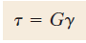
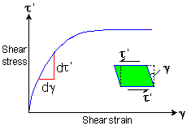
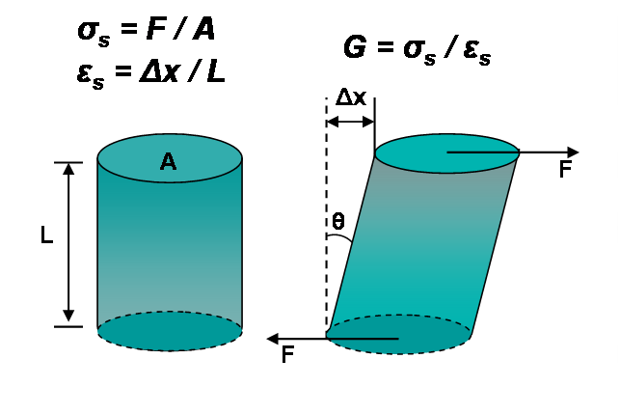
Elastic Deformation
Shear stress and strain are proportional to each other through the expression
Shear stress
Shear strain
shear modulus
G = τ/ɣ
G = σ_{s}/ε_{s}
τ (σ_{s}) = F/A
ɣ (ε_{s}) = Δx/L

Slide 22
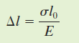
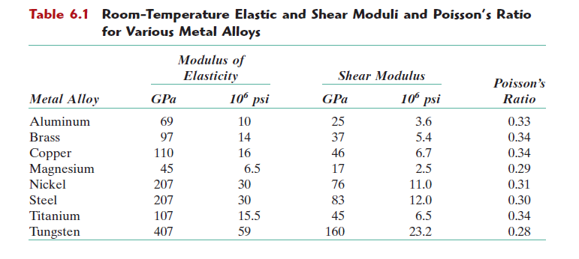
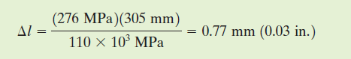
Example: Elongation (Elastic) Computation
A piece of copper originally 305 mm (12 in.) long is pulled in tension with a stress of 276 MPa (40,000 psi). If the deformation is entirely elastic, what will be the resultant elongation?
Solution
Because the deformation is elastic, strain is dependent on stress according to Hooke’s Law: σ = Eε and ε =Δl/l₀
σ =276 Mpa
l₀=305mm

Slide 23
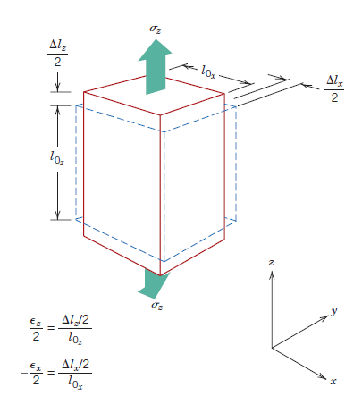
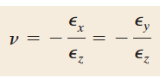
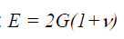
Elastic Deformation
Poisson Ratio
So far, we’ve considered stress only along one dimension…
But in reality;
Due to the elongation (z), there will be constrictions in the lateral (x and y) directions perpendicular to the applied
stress; => the compressive strains ε_{x} and ε_{y}
Solid lines represent dimensions after stress application; dashed lines, before.
If the applied stress is uniaxial (only in the z direction), and the material is isotropic => ε_{x} = ε_{y}
Poisson’s ratio
For isotropic materials, shear and elastic moduli are related to each other:

Slide 24
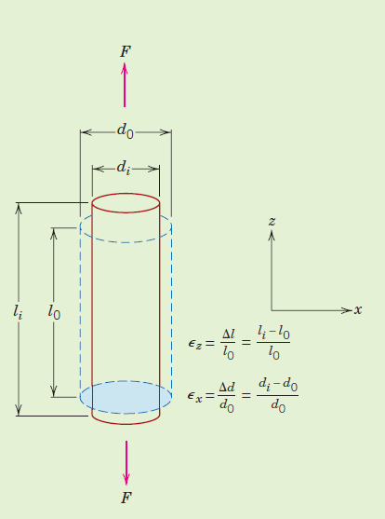
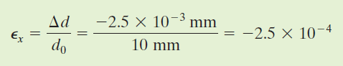
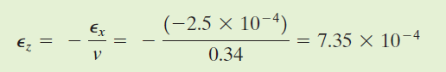
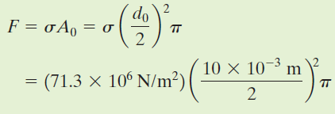
EXAMPLE: Computation of Load to Produce Specified Diameter Change
A tensile stress is to be applied along the long axis of a cylindrical brass rod that has a diameter of 10 mm. Determine the magnitude of the load required to produce a 2.5x10⁻³ mm change in diameter if the deformation is entirely elastic.
Solution
d₀: 10mm
Δd_{x} = 2.5x10⁻³ mm
negative, because the diameter is reduced
F = 5600 N

Slide 25
PLASTIC Deformation
A permanent deformation (upon removal of the stress they do not return to their original positions.)
•Atoms break bonds and form new ones.
•In metals, plastic deformation occurs typically at strain ≥0.005.

Slide 26
PLASTIC Deformation
A. Yield strength (σ_{y}): the strength required to produce a very slight yet specified amount of plastic deformation (the stress level at which plastic deformation begins)
What is the specified amount of strain?

Slide 27
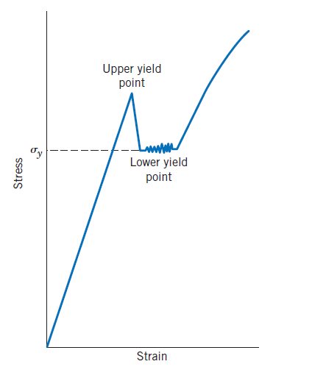
PLASTIC Deformation
A. Yield strength (σ_{y}):
Yield point phenomenon occurs when elastic-plastic transition is well-defined and abrupt. (e.i. Some steels and other materials)
No offset methods required here!!!
At the upper yield point, plastic deformation
is initiated with an apparent decrease in engineering stress. Continued deformation fluctuates slightly about some constant stress value, termed the lower yield point; stress subsequently rises with increasing strain
if σ_{y} is high, material is
resistant to plastic deformation.
For metals:
35 MPa – 1400 MPa

Slide 28
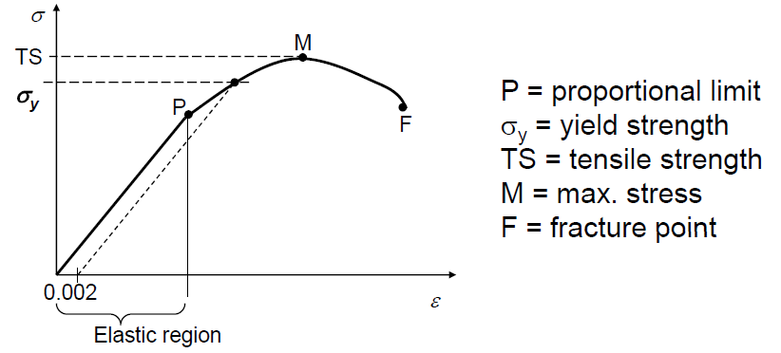
PLASTIC Deformation
B. Tensile Strength (TS): stress at the maximum of stress-strain curve. (the maximum stress that can be sustained by a structure in tension)

Slide 29
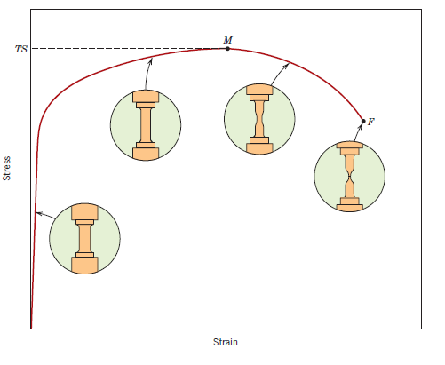
PLASTIC Deformation
Necking: at this maximum stress, a small constriction or neck begins to form at some point, and all subsequent deformation is confined at this neck
For metals:
TS = 50 MPa – 3000 MPa
fracture ultimately occurs at the neck

Slide 30
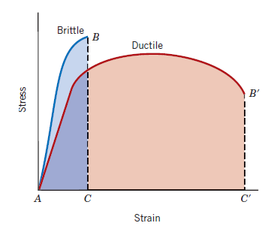
PLASTIC Deformation
C. Ductility: measure of degree of plastic deformation that has been sustained at fracture.
Ductile materials can undergo significant plastic deformation before fracture.
• Brittle materials can tolerate only very small plastic deformation.
A knowledge of the ductility of materials is important:
1- it indicates to a designer the degree to which a structure will deform plastically before fracture.
2- it specifies the degree of allowable deformation during fabrication operations.
Schematic representations of tensile stress–strain behavior for brittle and ductile metals loaded to fracture

Slide 31
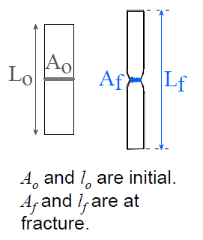
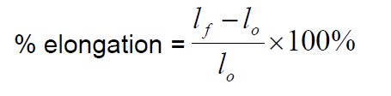
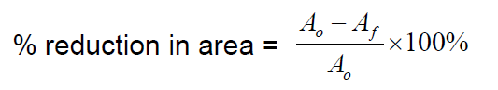
PLASTIC Deformation
Measure of ductility
Ductility may be expressed quantitatively as either percent elongation or percent reduction in area.
• Note: % AR and % EL are often different.
--Reason: crystal slip does not change material volume.
--%AR > %EL possible if internal voids form in neck.
Typically, materials are considered: brittle if %EL < 5%
ductile if %EL > 5%

Slide 32
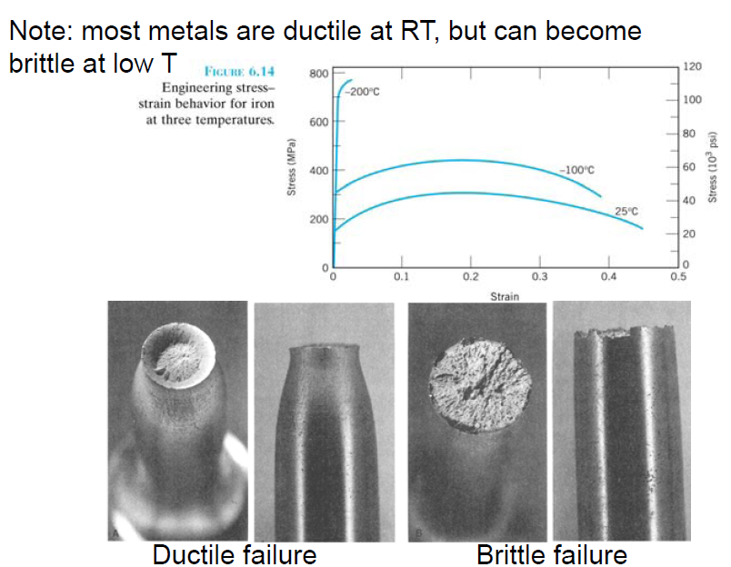
PLASTIC Deformation
C. Ductility:

Slide 33
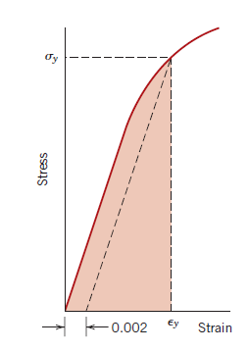
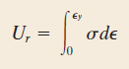
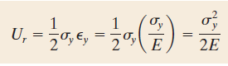
PLASTIC Deformation
D. Resilience: the capacity to absorb energy when deformed elastically and to have the absorbed energy recovered upon unloading.
U_{r}= modulus of resilience ( Area under the elastic region)
J/m³ or Pa
Assuming a linear elastic region,
Modulus of resilience for linear elastic behavior, and incorporating
Hooke’s law
Resilient materials have large yield strength and small elastic modulus. Such alloys would be used in spring applications.

Slide 34
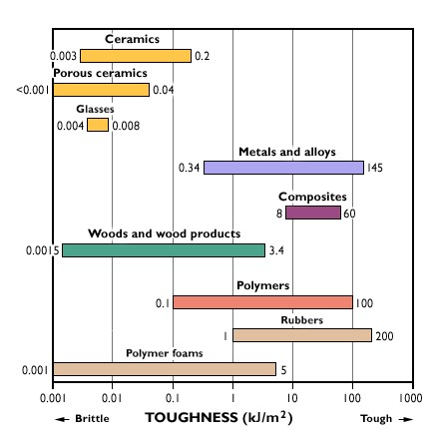


PLASTIC Deformation
E. Toughness: the ability of a material to absorb energy up to its fracture point
The general factors, affecting the toughness of a material are: temperature, strain rate, relationship between the strength and ductility of the material and presence of stress concentration (notch) on the specimen surface
Fracture toughness is indicated by the area below the curve on strain-stress diagram

Slide 35

Problem: From the tensile stress–strain behavior for the brass specimen shown in Figure, determine the following properties: (a) The modulus of elasticity, (b) The yield strength at a strain offset of 0.002, (c) The maximum load that can be sustained by a cylindrical specimen having an original diameter of 12.8 mm, (d) The change in length of a specimen originally 250 mm long that is subjected to a tensile stress of 345 MPa.

Slide 36



a)
b)
0.002 strain offset line corresponds to yield strength value of 250 MPa.
c)
Maximum stress can be achieved at tensile strength value (450 MPa).
d)
Point A corresponds to the 345 MPa tensile strength value. This corresponds to 0.06 strain value.

Slide 37




TRUE STRESS AND STRAIN
Typical engineering stress–strain behavior to fracture point
the decline in the stress necessary to continue deformation past the maximum, point M, seems to indicate that the metal is becoming weaker. This is not at all the case; as a matter of fact, it is increasing in strength.
The cross-sectional area is decreasing rapidly within the neck region.
The engineering stress is based on the original crosssectional area before any deformation and it does not take into account this reduction in area at the neck
more meaningful to use a true stress–true strain scheme.
ε _{T} : true strain
engineering stress
True stress (σ_{T} ) is defined as the load F divided by the instantaneous cross-sectional area A_{i} over which deformation is occurring.

Slide 38







TRUE STRESS AND STRAIN
If no volume change occurs during deformation—that is, if
true and engineering stress and strain are related according to
valid only to the onset of necking; beyond this point true stress and strain should be computed from actual load, cross-sectional area, and gauge length measurements.
K, n constants
n strain hardening exponent
A comparison of typical tensile engineering stress–strain and true stress–strain behaviors. Necking begins at point M on the engineering
curve, which corresponds to M‘ on the true curve. The “corrected” true stress–strain curve takes into account the complex stress state within the neck region.

Slide 39

ELASTIC RECOVERY AFTER PLASTIC DEFORMATION
Upon release of the load during the course of a stress–strain test, some fraction of the total deformation is recovered as elastic strain
In plastic deformation region, relasing loading (D)=> the curve traces a near straight-line path from the point of unloading (point D),virtually identical or parallel to the modulus of elasticity curve.
If the load is reapplied, the curve will traverse essentially the same linear portion
in the direction opposite to unloading.

Slide 40


Problem: A cylindrical specimen of steel having an original diameter of 12.8 mm is tensile-tested to fracture and found to have an engineering fracture strength of 460 MPa. If its cross-sectional diameter at fracture is 10.7 mm, determine: (a) The ductility in terms of percent reduction in area, (b) The true stress at fracture.
(a)

Slide 41



b)

Slide 42



Problem: Compute the strain-hardening exponent n for an alloy in which a true stress of 415 MPa produces a true strain of 0.10; assume a value of 1035 MPa for K.

Slide 43
PROPERTIES OBTAINED FROM THE TENSILE TEST
Yield Strength
Elastic Limit
Tensile Strength, Necking
Hooke’s Law
Poisson’s Ratio
Young’s Modulus (Modulus of Elasticity)
Resilience
Toughness

Slide 44

HARDNESS
Hardness: measure of a material’s resistance to localized plastic deformation (e.g., a small dent or a scratch)
Early hardness tests were based on natural minerals with a scale constructed solely on the ability of one material to scratch another that was softer.
The Mohs Scale was developed by the German geologist Friedrich Mohs in 1812 and describe the hardness of a given mineral or gemstone.
Diamond was, at the time, the hardest material known to exist so is at the top of the list, with Talc being at the bottom.
Notes:
Another mechanical property that may be important to consider is hardness

Slide 45


Summary of hardness testing methods

Slide 46

Comparison of several hardness scales.

